Slide 1
10.10.2018
Color scheme painting

Slide 2
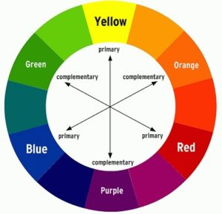
10.10.2018
When you come into class pick up:
Water container with water in it
Paper towel
A brush(can be rough or flat)
You will share a palette with a neighbor
Think about which 6 colors to make your own color palette with

Slide 3
Iron Horse Assembly Schedule
2nd period | 8:55 | - | 10:00 AM | (65 minutes)
3rd period | 10:05 | - | 11:10 AM | (65 minutes)
Lunch | 11:10 | - | 11:40 AM | (30 minutes)
4th period | 11:45 | - | 12:50 PM | (65 minutes)
5th period | 12:55 | - | 2:00 PM | (65 minutes)
Advisory | 2:05 | - | 2:10 PM | (5 minutes)
Assembly | 2:10 | - | 2:35 PM | (25 minutes)

Slide 4
Agenda 10.10.2018
Figure out which 6 colors you want to use for your color scheme(you can mix any additional colors using the 6 colors you pick)
Sketch out three different ideas on the project plan paper
Start the color scheme painting

Slide 5
Reminders
Grades have been updated since we did the survey last class & turned in our fruit/veg paintings
Fruit/Veg paintings were graded based on – light source, shadow, and completely painted fruit/veg
If you missed a point you were missing one of those 3 things
You can also add to a painting or re-do a painting if you want to improve your grade
Last day to turn in work for term 1, October 25th

Slide 6
Color Palettes and Color Schemes

Slide 7
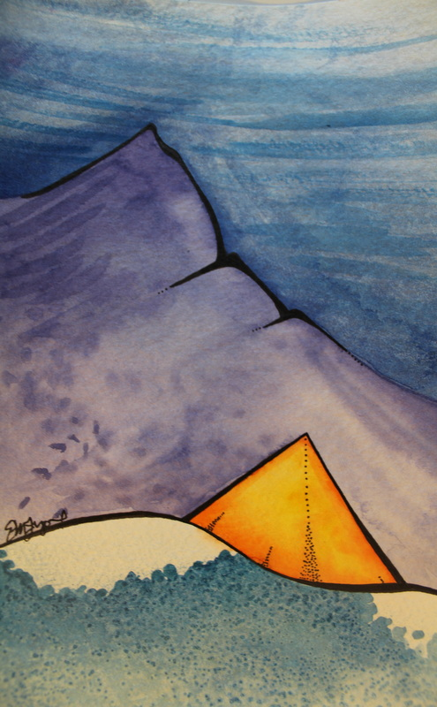
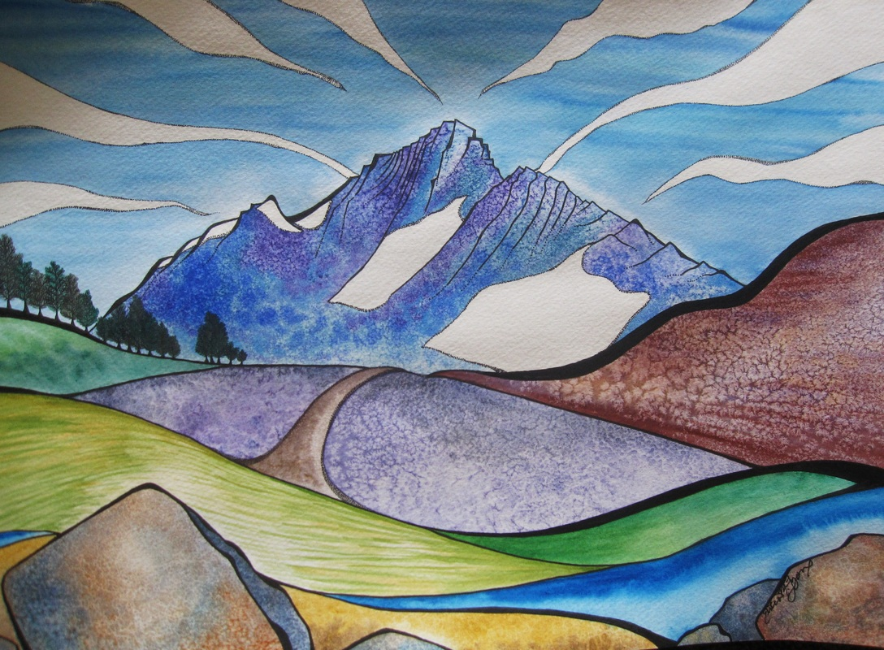
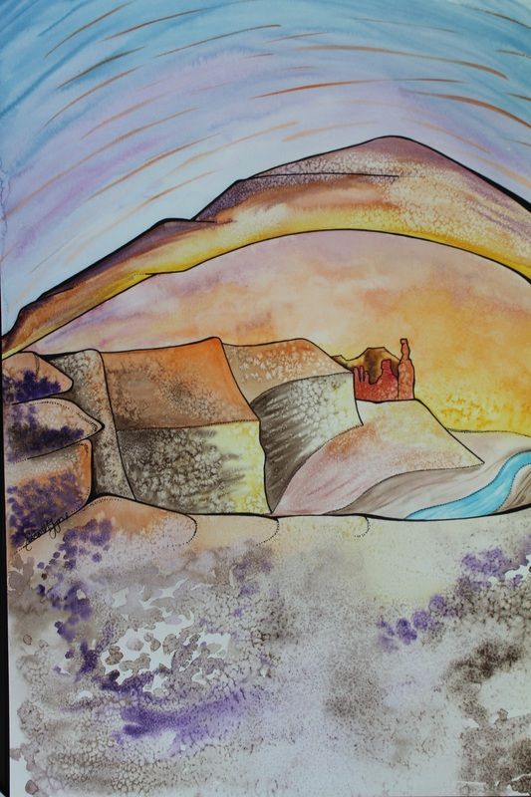
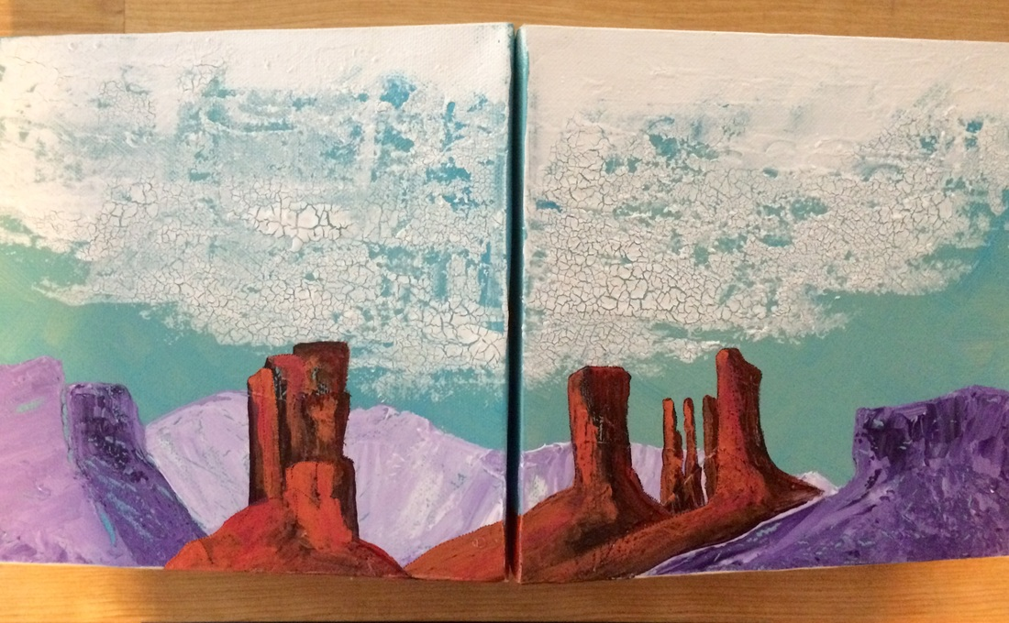
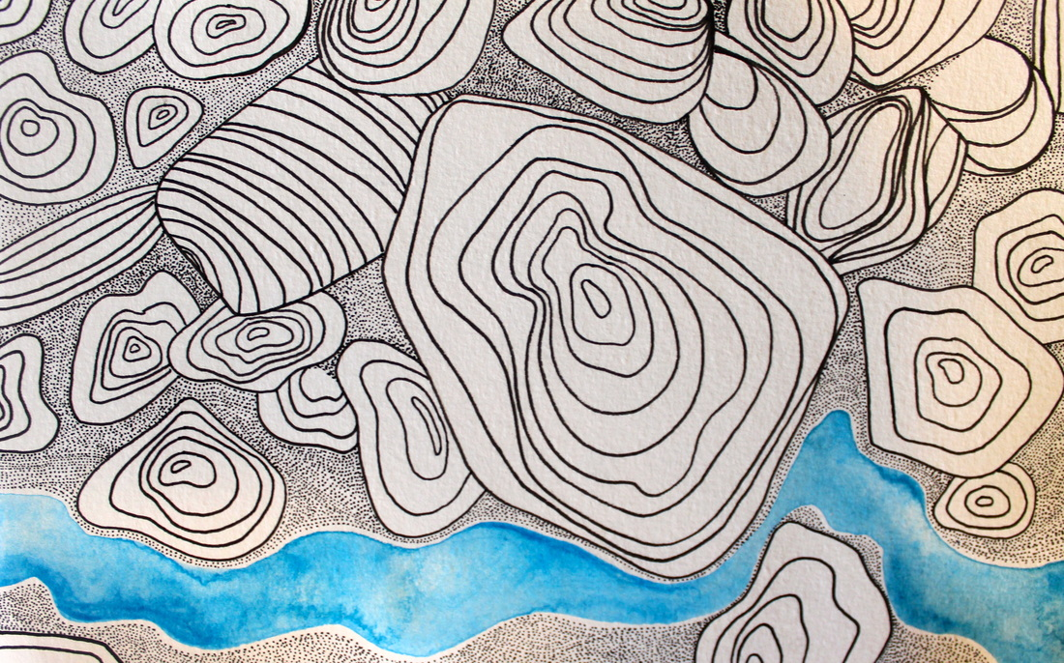
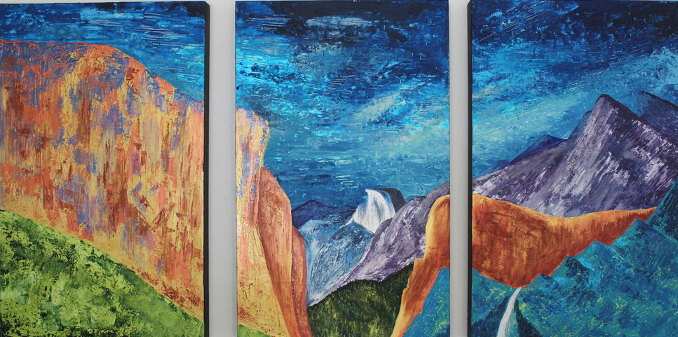
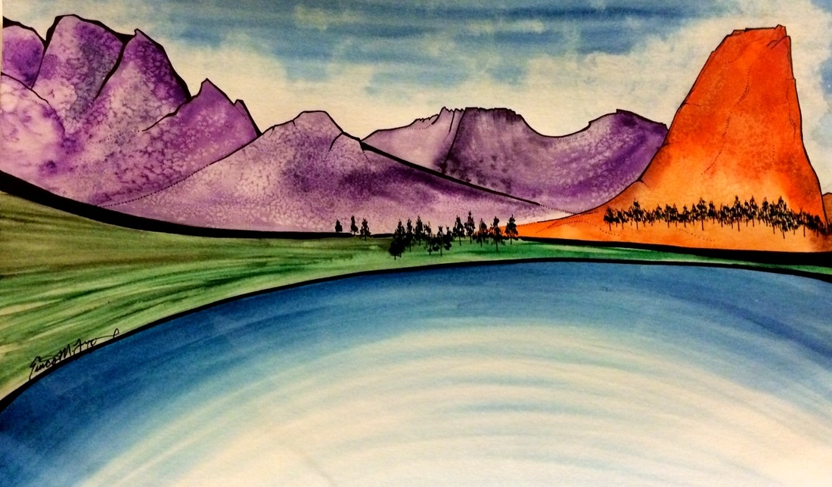
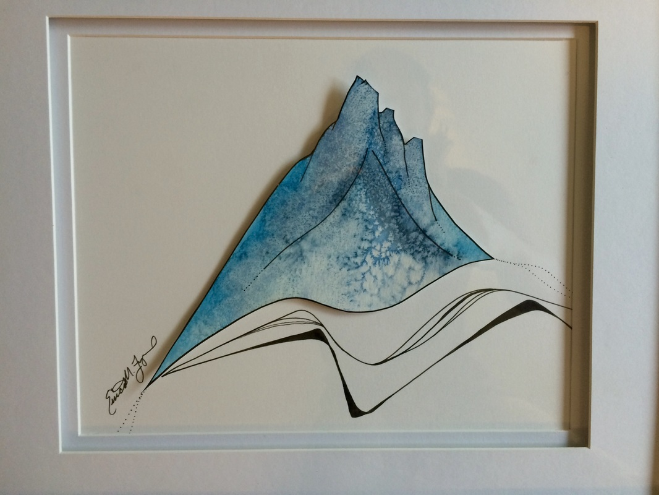
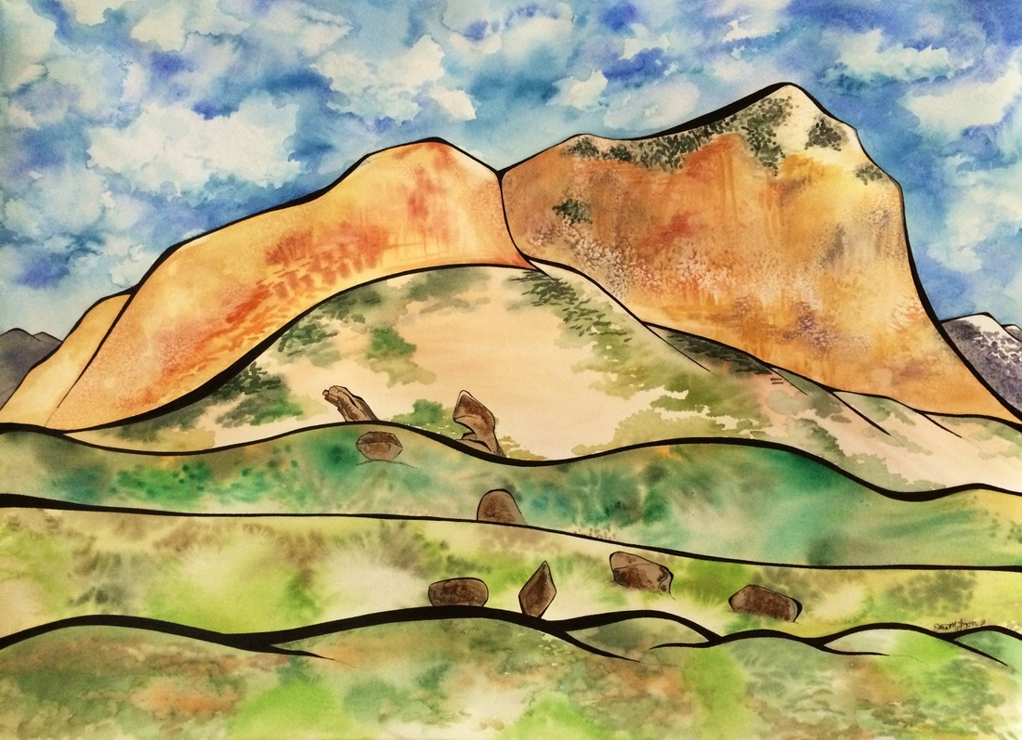

Slide 8
Sketches 3
Sketch out three ideas for your color scheme painting
Label the sketch you want to use with the colors you are going to use and paint the colors you are using on a test watercolor paper, test out mixing the colors
When you are done with your sketches, show me and you can get final paper – this painting will be due at the end of next class

Slide 9
Clean up!
Please make sure paint colors are in the right containers
Water containers back in the cupboard
Leave paints open and stacked
Make sure that you table is dry and clean
Thank you!

Slide 10
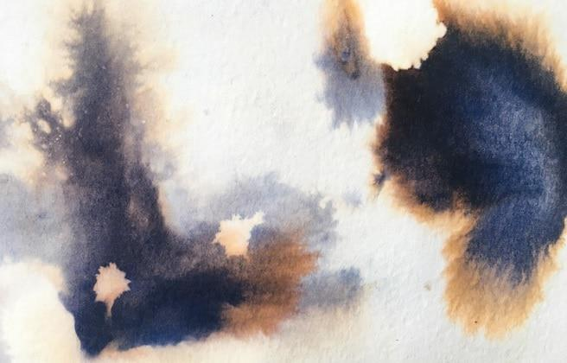
Due today by the end of class
6 colors for your color scheme on small watercolor paper
3 sketches of your ideas for your painting
Your final painting, using your color scheme and one of your sketches(or maybe you combined your sketches)
Next class – quink ink – blue and black ink that dries gold on the edges!

